Slide 1
DataFrames & SparkSQL
Week-4
Learn about Resilient Distributed Datasets (RDDs), their uses in Apache Spark, and RDD transformations and actions. You'll compare the use of datasets with Spark's latest data abstraction, DataFrames. You'll learn to identify and apply basic DataFrame operations. Explore Apache Spark SQL optimization. Learn how Spark SQL and memory optimization benefit from using Catalyst and Tungsten. Learn how to create a table view and apply data aggregation techniques. Fortify your skills guided via the hands-on lab.
Learning Objectives
Describe Resilient Distributed Datasets (RDDs) and their uses in Apache Spark.
Describe dataset features, benefits, and creation in Apache Spark and contrast datasets with DataFrames.
Describe Apache Spark SQL optimization, how Catalyst and Tungsten benefit Spark SQL, and how Spark performs SQL and memory optimization using Catalyst and Tungsten.
Identify basic DataFrame operations and apply them, using Spark DataFrames, on real-world data.
Load, view, manipulate, and aggregate data in a DataFrame.
Define Spark SQL and identify supported data sources
Create a DataFrame table view, aggregate data in the table view.
Create a Pandas user-defined function (UDF) to perform columnar operations.

Slide 2
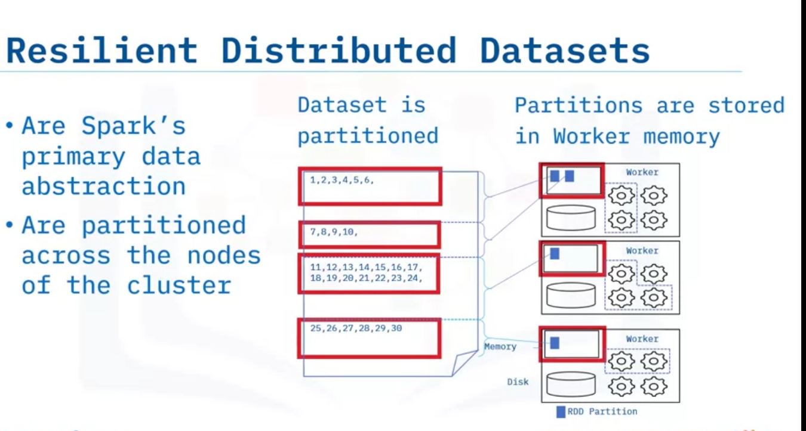
RDDs in Parallel Programming and Spark
Describe Resilient Distributed Datasets,
explain how to use Resilient Distributed Datasets in Spark,
explain RDD transformation and actions, and list
fundamental transformations and actions
Resilient Distributed Datasets, known as RDDs, are Spark's primary data abstraction and are partitioned across a cluster's nodes.

Slide 3
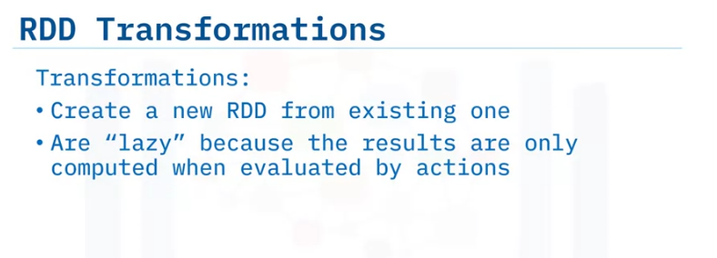
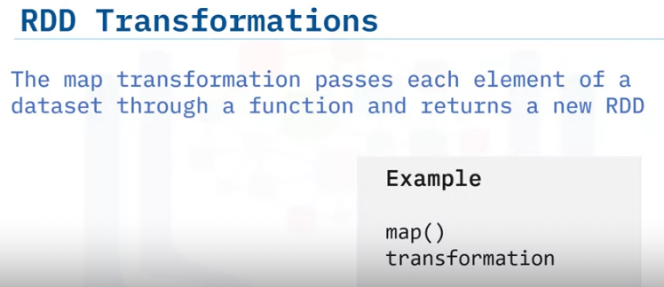
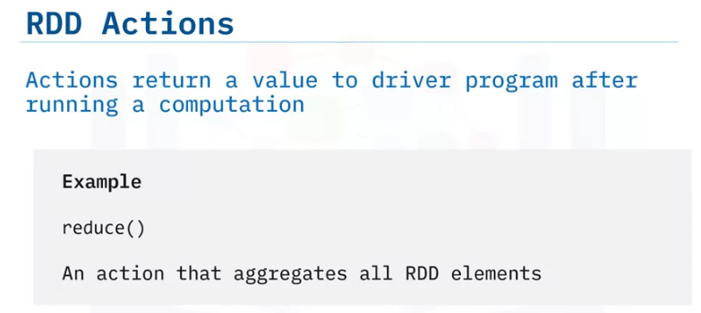
The first RDD operation to explore is a Transformation.
An RDD transformation creates a new RDD from an existing RDD.
Transformations in Spark are considered lazy because Spark does not compute transformation results immediately. Instead, the results are only computed when evaluated by "actions."
For example, the map transformation passes each element of a dataset through a function resulting in a new RDD.
To evaluate a transformation in Spark, you use an action. The action returns a value to the driver program after running a computation.
One example is the reduce action, which aggregates all the elements of an RDD and returns the result to the driver program.
By default, RDD transformation doesn’t perform calculations to get the transformed value. Instead, you need to call an action on it.

Slide 4
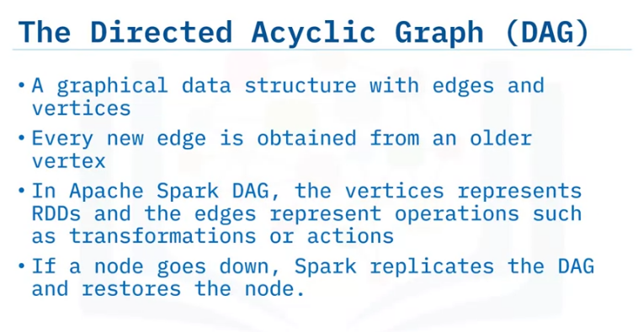
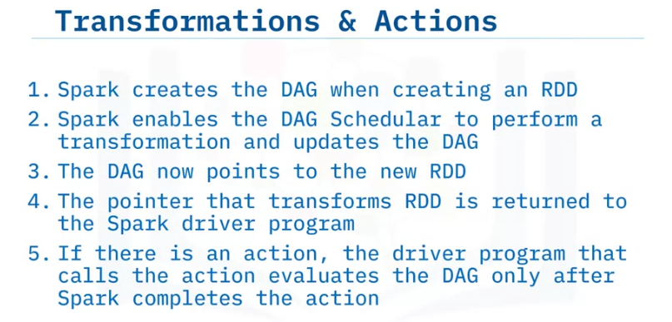
But how do transformations and actions happen? Spark uses a unique data structure called a Directed Acyclic Graph, knowns as a DAG, and an associated DAG Scheduler to perform RDD operations.
Think of a DAG as a graphical structure composed of edges and vertices.
The term "acyclic" means that new edges only originate from an existing vertex.
In general, the vertices and edges are sequential.
The vertices represent RDDs, and the edges represent the transformations or actions.
The DAG Scheduler applies the graphical structure to run the tasks that use the RDD to perform transformation processes.
So, why does Spark use DAGs? DAGS help enable fault tolerance.
When a node goes down, Spark replicates the DAG and restores the node.
Let's look at the process in more detail.
First, Spark creates DAG when creating an RDD.
Next, Spark enables the DAG Schedular to perform a transformation and updates the DAG.
The DAG now points to the new RDD.
The pointer that transforms RDD is returned to the Spark driver program.
And, if there is an action, the driver program that calls the action evaluates the DAG only after Spark completes the action.

Slide 5
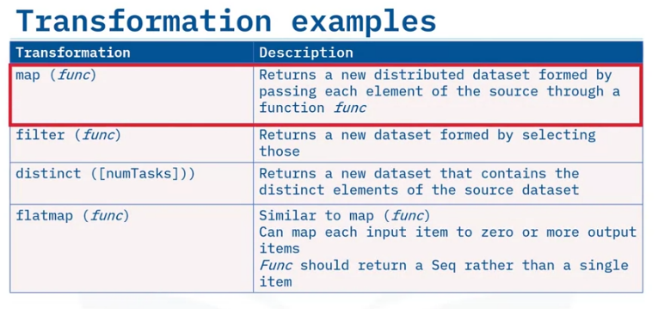
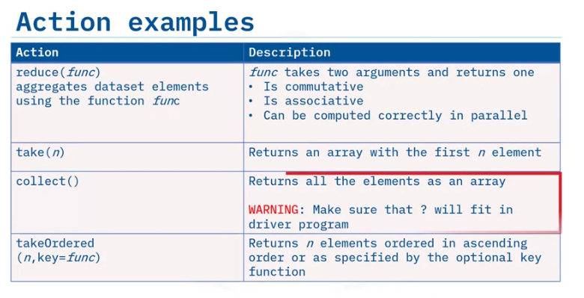
Here are some examples of RDD transformations and actions.
map, which is an essential operation and capable of expressing all transformations needed in data science.
Some of the more common high-level transformations making use of map and reduce include: filter, which enables filtering the elements of a dataset based on a function, and distinct, which finds the number of distinct elements in a dataset.
In addition, the flatmap transformation, which is similar to the map transformation, can map each input item to zero or greater output items.
Its function should return a sequence rather than a single item.
Next, frequently used actions include: reduce, which aggregates dataset elements using the function func.
take, which returns an array with the first n element, collect, which returns all the elements of the dataset as an array and takeOrdered, which returns elements ordered in ascending order or as specified by an optional function argument

Slide 6
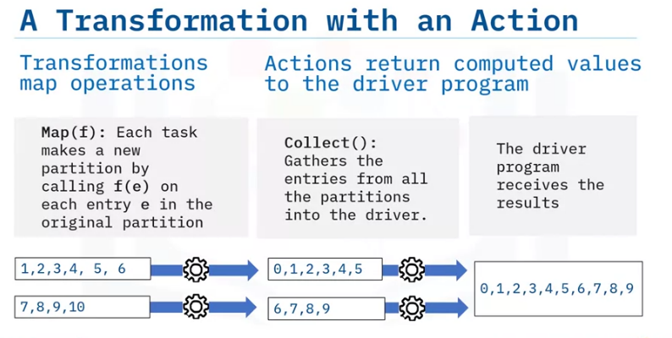
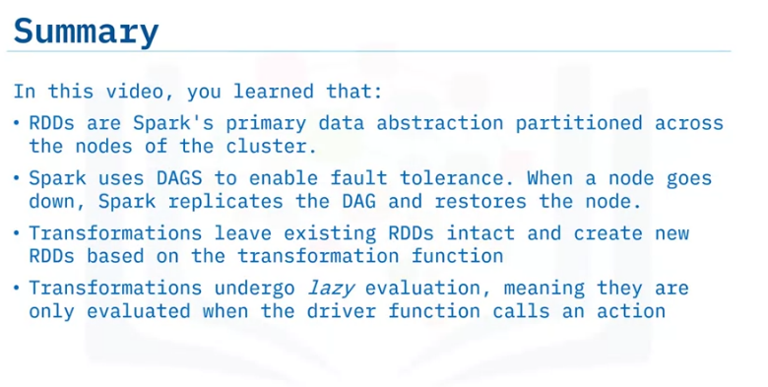
A transformation is only a mapping of operations. You need actions to get the computed values to the driver program:
This example considers a function f of x that decrements x by 1. So, f (x) = x - 1
You'll apply this function as a transformation to a dataset using the map transformation.
Each task makes a new partition by calling f of e on each entry e in the original partition.
Then, the collect action gathers the entries from all the partitions into the driver, which receives the results.

Slide 7
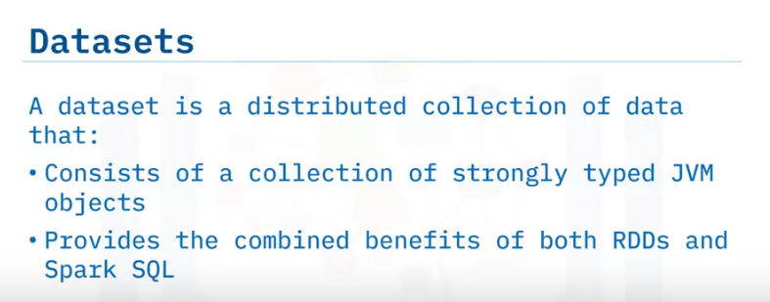
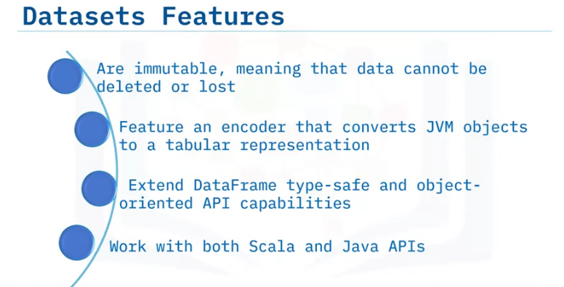
Data-frames and Datasets
Describe dataset features and benefits within Apache Spark,
explain three ways you can create datasets for use in Spark,
summarize the differences between datasets and Data-frames.
Datasets are the newest Spark data abstraction.
Like RDDs and DataFrames, datasets provide an API to access a distributed data collection.
Datasets are a collection of strongly typed Java Virtual Machine, or JVM, objects.
Strongly typed means that datasets are typesafe, and the dataset’s datatype is made explicit during its creation.
Datasets provide the benefits of both RDDs, such as lambda functions, type-safety, and SQL Optimizations from SparkSQL
Speaking of benefits, here are four more features of datasets:
Datasets are immutable. Like RDDs, they cannot be deleted or lost.
Datasets feature an encoder that converts type-specified JVM objects to a tabular representation.
Datasets extend the DataFrame API. Conceptually a dataset of a generic untyped “Row” is a JVM object seen as a column of a DataFrame.
Because datasets are strongly typed, APIs are currently only available in Scala and Java, which are statically typed languages. Dynamically typed languages, such as Python and R, do not support dataset APIs.

Slide 8
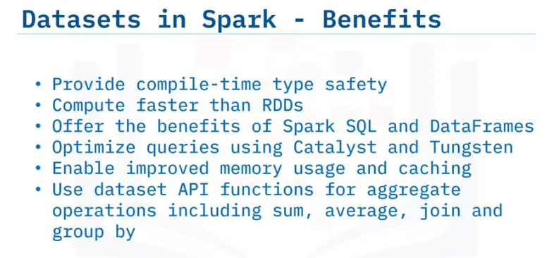
Datasets offer some unique advantages and benefits over using DataFrames and RDDs.
Because Datasets are statically-typed, datasets provide compile-time type safety.
Compile-time type safety means that Spark can detect syntax and semantic errors in production applications before deployment, saving substantial developer and operational costs and time.
Datasets compute faster than RDDs, especially for aggregate queries.
Datasets offer the additional query optimization enabled by Catalyst and Tungsten.
Datasets enable improved memory usage and caching. But how?
Spark understands the data structure of the datasets and optimizes the layout within memory.
The dataset API also offers functions for convenient high-level aggregate operations, including sum, average, join, and “group-by.

Slide 9
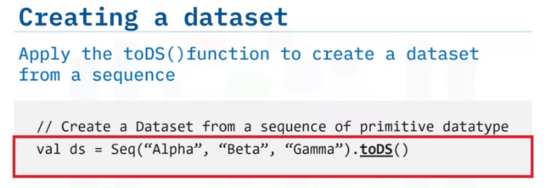
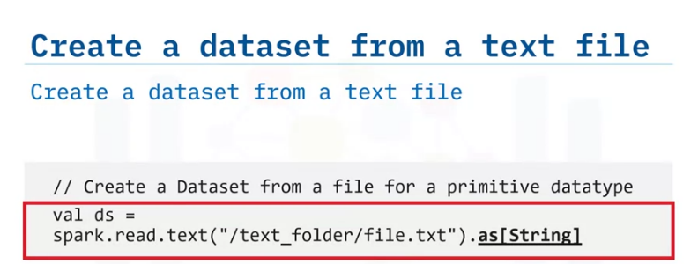
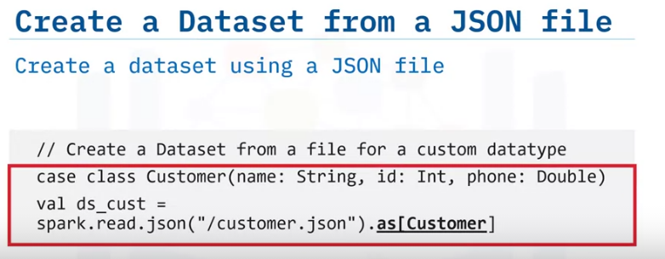
Let’s now look at three ways that you can create a dataset within Spark.
This first example, written in Scala, uses the toDS function to create a dataset from a sequence.
This second example illustrates how to create a dataset from a text file. Notice the explicit schema declaration. In this example, we apply the primitive “String” data type to the explicit schema declaration.
3. This third and final example creates a dataset using a JSON file. In this last example, we use a custom class called “Customer,” which contains a “name” and an “ID” field.

Slide 10
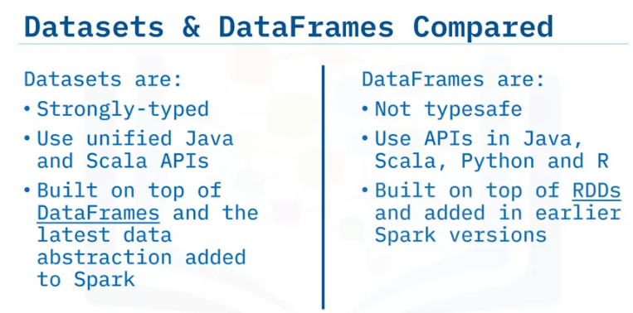
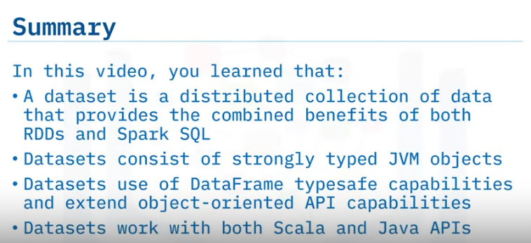
Next, let’s compare datasets to DataFrames.
Datasets offer the benefits of both its predecessors – DataFrames and RDDs.
Datasets are strongly typed. DataFrames are not typesafe.
Datasets can use unified Java and Scala APIs. DataFrames use APIs that are written in Java, Scala,
Python, and R. The DataFrames API may or may not be unified depending on the API version.
Datasets are the latest addition to Spark and are built on top of DataFrames.
In contrast, DataFrames, introduced earlier, are built on RDDs.

Slide 11
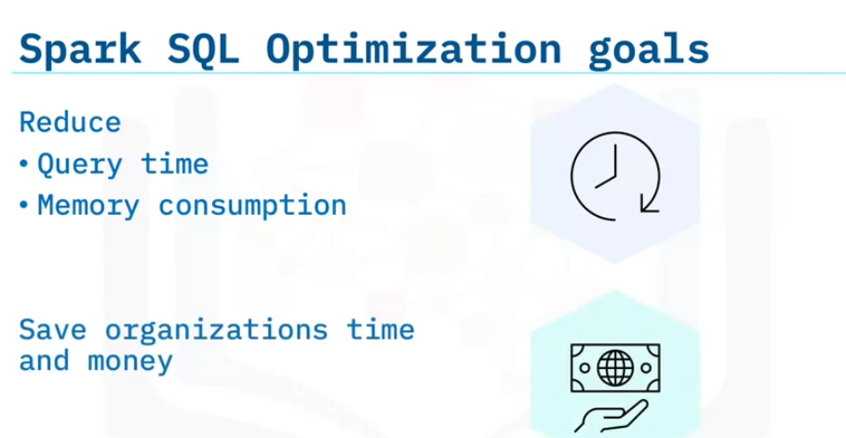
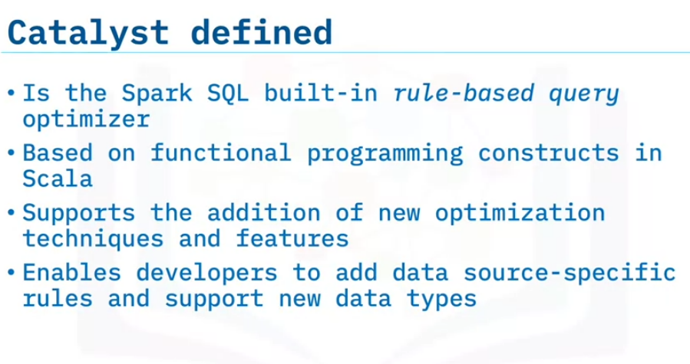
Catalyst and Tungsten
Describe the goals of Apache Spark SQL Optimization,
describe how Catalyst and Tungsten benefit Spark SQL,
explain how Spark performs SQL and memory optimization using Catalyst and Tungsten.
The primary goal of Spark SQL Optimization is to improve the SQL query run-time performance reducing the query’s time and memory consumption, saving organizations time and money.
Spark SQL supports both rule-based and cost-based query optimization.
Catalyst, also known as the Catalyst Optimizer, is the Spark SQL built-in rule-based query optimizer.
Based on Scala functional programming constructs, Catalyst is designed to easily add new optimization techniques and features to Spark SQL.
Developers can extend the optimizer by adding data-source-specific rules and support for new data types.

Slide 12
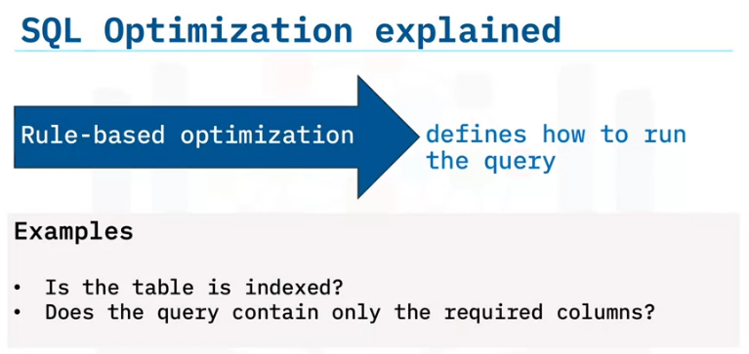
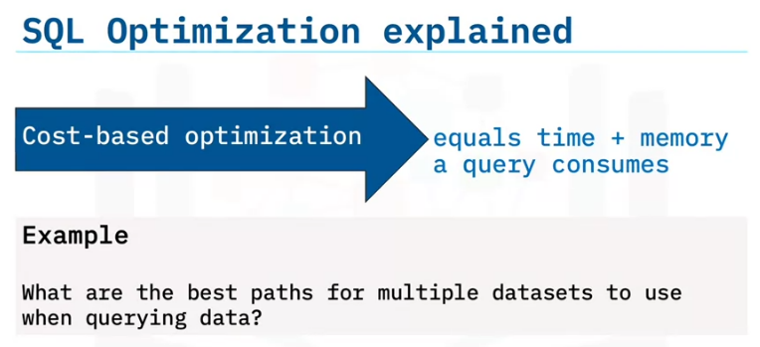
During rule-based optimization, the SQL optimizer follows predefined rules that determine how to run the SQL query.
Examples of predefined rules include validating that a table is indexed and checking that a query contains only the required columns.
With the query itself optimized, cost-based optimization measures and calculates cost based on the time and memory that the query consumes.
The Catalyst optimizer selects the query path that results in the lowest time and memory consumption.
Because queries can use multiple paths, these calculations can become quite complex when large datasets are part of the calculation. Consider the analogy of a car and your travels.
A car owner can optimize the vehicle’s performance with the right oil, tires, fuel, and so on.
These actions are similar to rule-based optimization.
When it’s time to plan a travel route that can save both time and wear and tear on your car, those actions are a form of cost-based optimization.

Slide 13
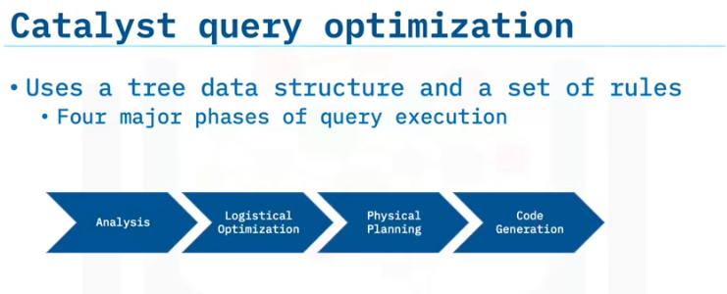
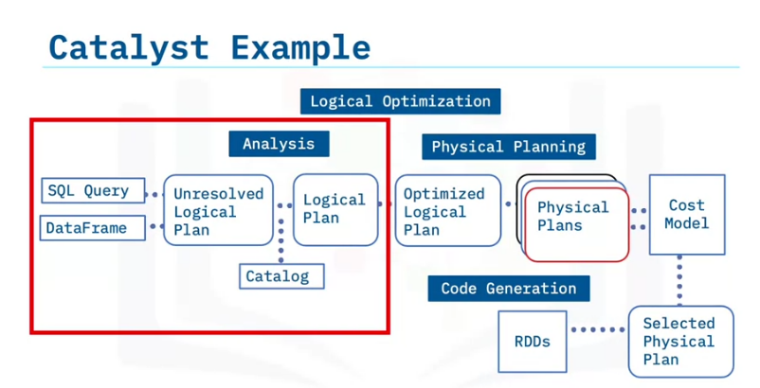
In the background, the Catalyst Optimizer uses a tree data structure and provides the data tree rule sets.
To optimize a query, Catalyst performs the following four high-level tasks or phases: analysis, logical optimization, physical planning, and code generation.
Let’s review the four Catalyst phases:
In the Analysis phase, Catalyst analyzes the query, the DataFrame, the unresolved logical plan, and the Catalog to create a logical plan.
During the Logical Optimization phase, the Logical plan evolves into an Optimized Logical Plan.
This is the rule-based optimization step of Spark SQL and rules such as folding, pushdown, and pruning are applied here.
During the Physical Planning phase, Catalyst generates multiple physical plans based on the Logical Plan.
A physical plan describes computation on datasets with specific definitions on how to conduct the computation.
A cost model then chooses the physical plan with the least cost. This is the cost-based optimization step.
The final phase is Code Generation. Catalyst applies the selected physical plan and generates Java bytecode to run on each node.

Slide 14
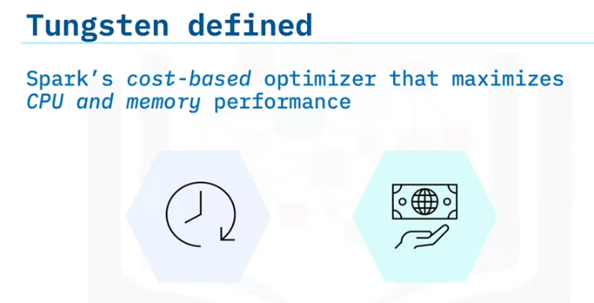
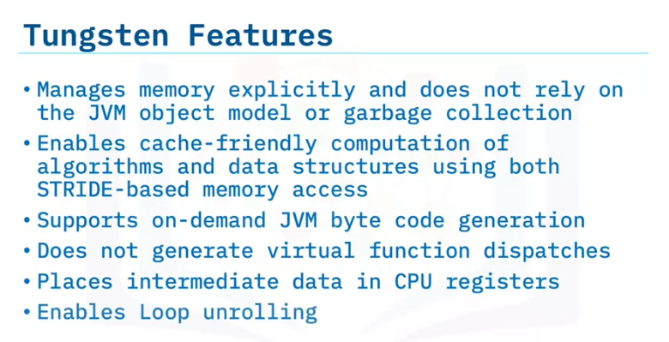
Let’s now examine how Tungsten provides cost-based optimization in Spark.
Tungsten optimizes the performance of underlying hardware focusing on CPU performance instead of IO.
Java was initially designed for transactional applications. Tungsten aims to improve CPU and Memory performance by using a method more suited to data processing for the JVM to process data.
To achieve optimal CPU performance, Tungsten applies the following capabilities: Tungsten manages memory explicitly and does not rely on the JVM object model or garbage collection.
Tungsten creates cache-friendly data structures that are arranged easily and more securely using STRIDE-based memory access instead of random memory access.
Tungsten supports JVM bytecode on-demand.
Tungsten does not enable virtual function dispatches, reducing multiple CPU calls.
Tungsten places intermediate data in CPU registers and enables loop unrolling

Slide 15
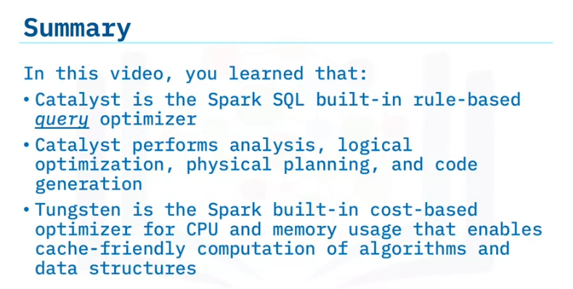

Slide 16
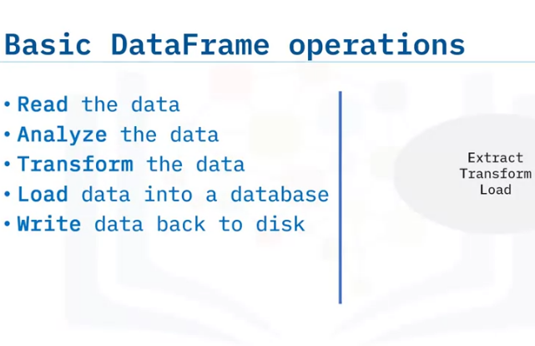
Identify the basic DataFrame operational steps,
apply basic DataFrame operations on real-world data,
apply Spark DataFrames to real-world data
ETL with DataFrames
basic DataFrame operations: Reading, Analysis, Transformation, Loading, and Writing.
First, Spark reads in the data and loads the data into a DataFrame.
Next, you can analyze the dataset, starting with simple tasks such as examining the columns, data types, number of rows, and optionally working with aggregated stats, trend analysis, and other operations.
If needed, you can transform the data by filtering the data to locate specific values, sorting the dataset based on specific criteria, or by joining this dataset with another dataset.
Then you can load your transformed dataset back to a database or a file system and write the data back to disk.
This process is commonly also referred to as ETL – Extract, Transform, Load. ETL is an essential process in any data processing pipeline as the first step makes data accessible to data warehouses for machine learning models, downstream applications, or other services.

Slide 17
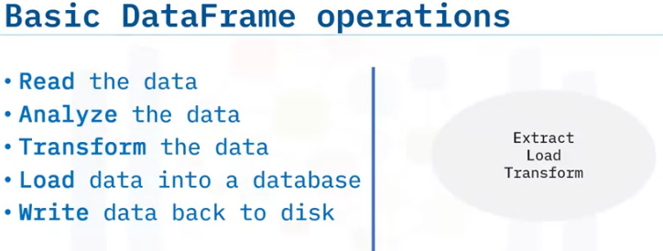
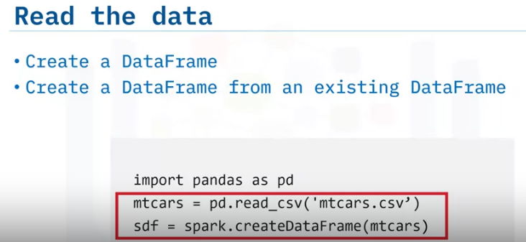
Let's talk about another standard process. ELT – Extract, Load, and Transform.
This process emerged as a result of big data processing. With ELT, all of the data resides in a data lake.
A data lake is a vast pool of raw data, for which the purpose of the data is not pre-defined.
When a data lake exists, each project forms individual transformation tasks as required, in contrast to anticipating all necessary transformation requirements usage scenarios as done with ETL and a data warehouse.
Organizations often use a mixture between both ETL and ELT.
Let's take a closer look at each basic DataFrame operation.
When reading the data, you can directly load data into DataFrames or create a new Spark DataFrame from an existing DataFrame.
The displayed code sample shows how to load a dataset into a Pandas DataFrame in Python and then load that same dataset into a Spark DataFrame object.

Slide 18
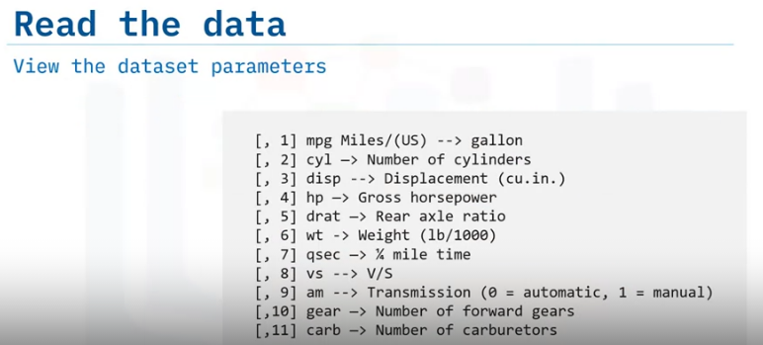
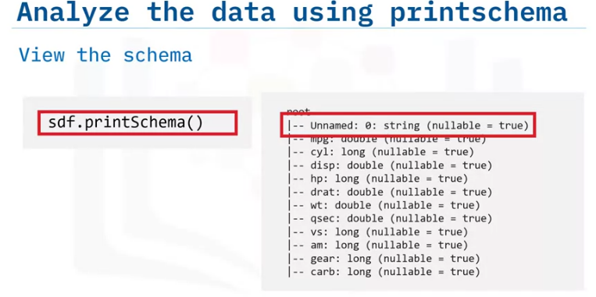
Let's continue the example that uses the dataset about car models and performance.
This dataset contains columns for parameters such as miles per gallon, number of cylinders, horsepower, and other auto-related parameters.
Here you can view the first few rows of the dataset. Next is analyzing the data.
First, examine the DataFrame column data types or the schema, using the print schema method.
Take note of each column's data types. For example, the miles per gallon is a "double" type, while the first column indicates the car model name is a string.

Slide 19
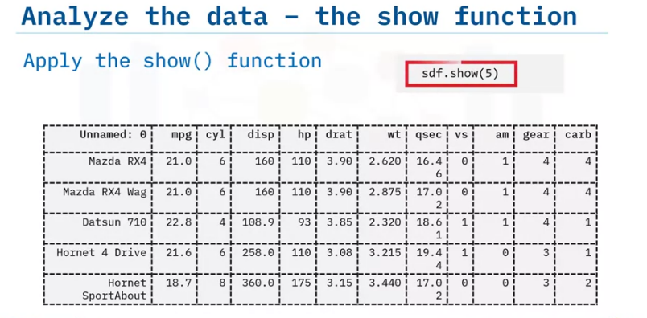
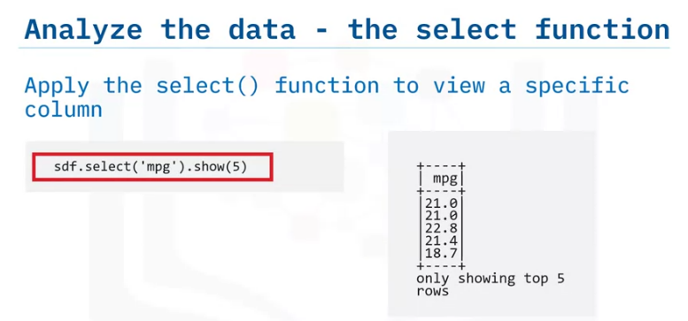
You can also examine a specified number of DataFrame using the show function.
You can apply the select function to examine data from a specific column in detail.
This example applies the select function to view the first five rows of the "mpg" column.

Slide 20
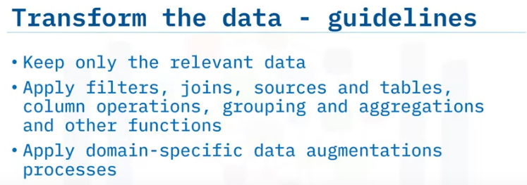
After analyzing the dataset, your next step is to plan for any needed dataset transformations.
The goal of a transformation is to retain only relevant data.
Transformation techniques can include filtering the data, joining with other data sources, or performing columnar operations.
Columnar operations are actions such as multiplying each column by a specific number, converting data from one unit to another, such as converting miles per gallon to kilometers per liter.
Another common transformation technique is to group or aggregate data.
Sometimes a downstream application may require aggregated data, such as a quarterly sales report that does not need to display every transaction but needs to show the aggregated total quarterly sales and revenue numbers.
Many transformations are domain-specific data augmentation processes.
The effort needed can vary depending on the domain and the data.
For example, scientific datasets involving multiple, differing measurements may require more columnar operations and unit conversions, while financial data can require more aggregation and averaging tasks.

Slide 21
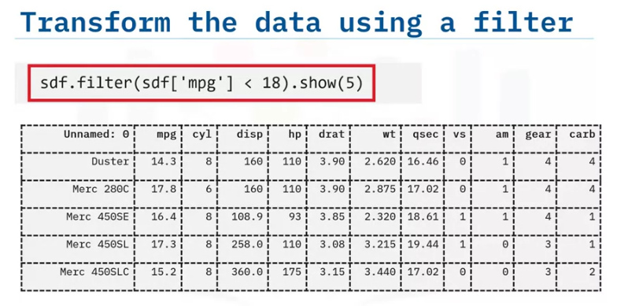
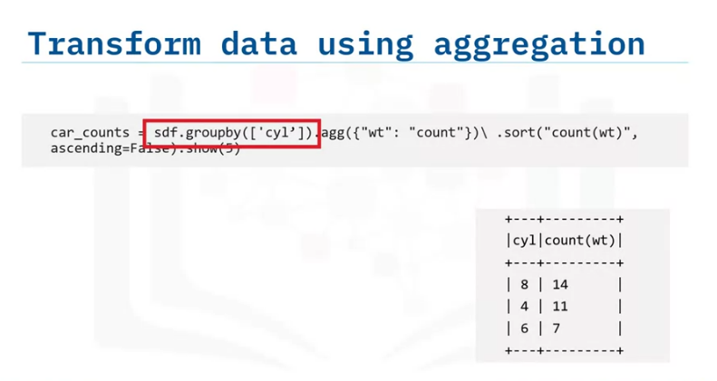
Here are some simple examples of transformations on the mtcars dataset.
The filter function helps locate specific criteria within the dataset.
In this case, the task is to filter the dataset for cars that have a mileage, or mpg, of less than 18 miles per gallon.
Here is an example of aggregating data.
In this example, the transformation aggregates all the records with the same number of cylinders, as seen in the "cyl" column, counts the number of vehicles with the specified number of cylinders, and sorts the data to list the number of units for each cylinder category in ascending order.
We can see that 14 cars have an 8-cylinder engine and 11 cars have a 4-cylinder engine.

Slide 22
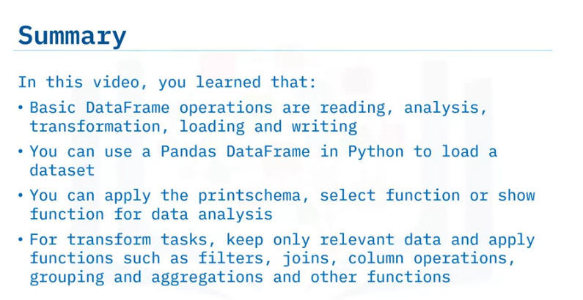

Slide 23
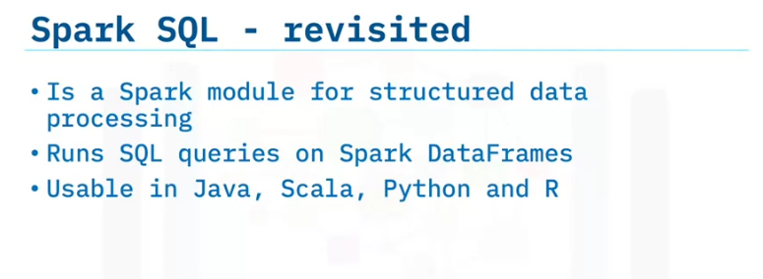
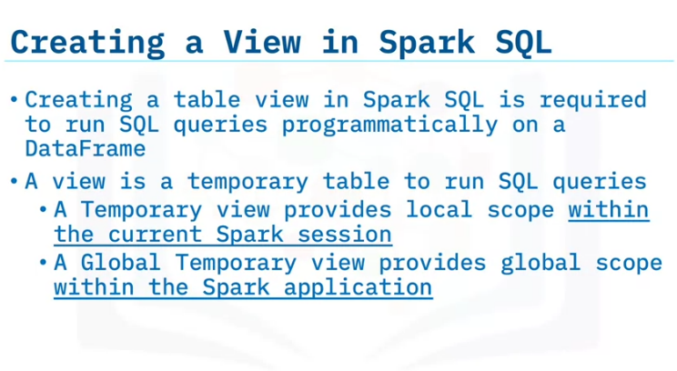
Real-world usage of SparkSQL
Define Spark SQL,
create a table view in Spark SQL,
explain how to aggregate data using Spark SQL,
explain the various data sources Spark SQL supports.
Spark SQL Is a Spark module for structured data processing.
Spark SQL is used to run SQL queries on Spark DataFrames and has available APIs in Java, Scala, Python, and R.
The first step to running SQL queries in Spark SQL is to create a table view. A table view is a temporary table used to run SQL queries.
Spark SQL supports both temporary and global temporary table views.
A temporary view has local scope.
Local scope means that the view exists only within the current spark session on the current node.
A global temporary view, however, exists within the general Spark application.
A global temporary view is shareable across different Spark sessions.

Slide 24
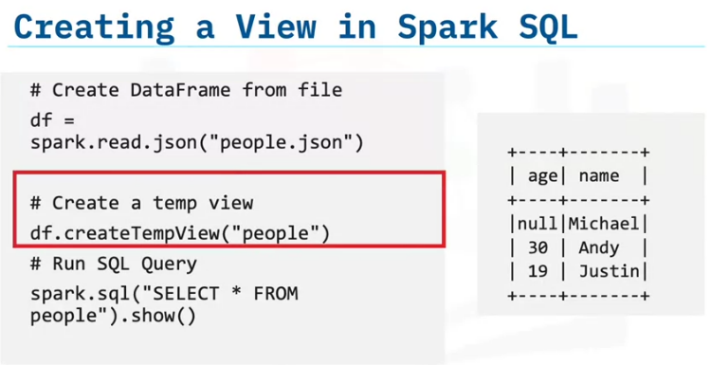
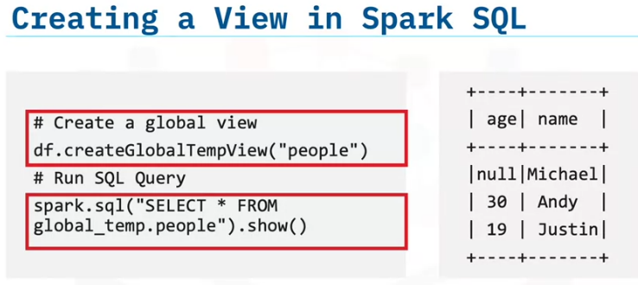
Here is an example that shows how to create a temporary view in Python using PySpark.
You first create the DataFrame from the JSON file, then create a temporary view called "people."
You can then run a SQL query using this view.
Here is the same example, but this time, you are creating a Global Temporary View.
Note the minor syntax change, including the "Global" prefix to the function name and the "global temp" prefix to the view name.

Slide 25
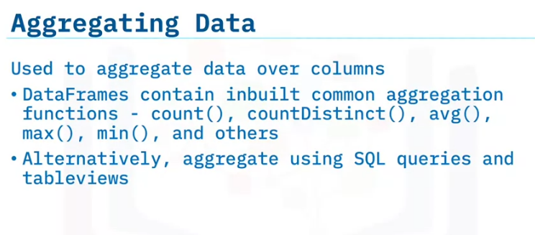
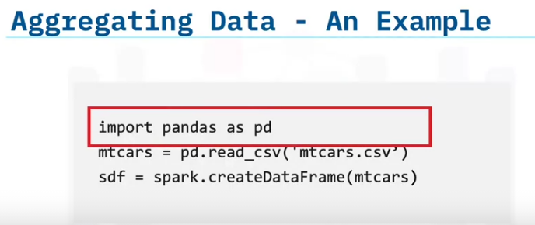
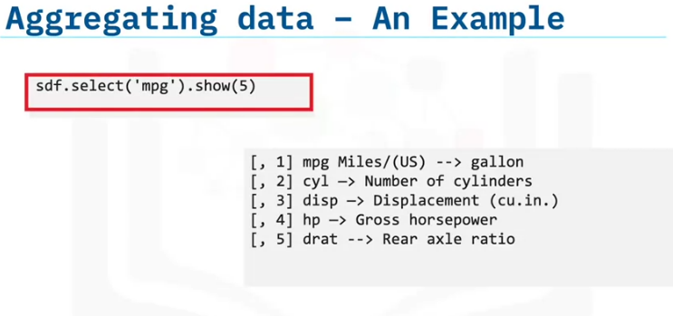
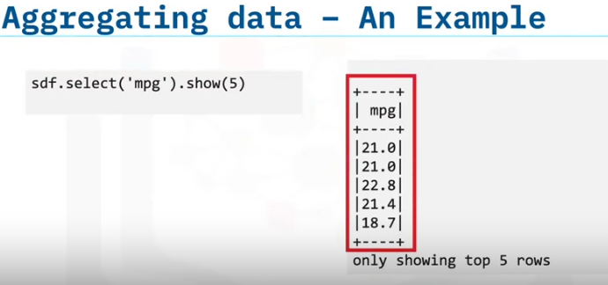
Aggregation, a standard Spark SQL process, is generally used to present grouped statistics.
DataFrames come inbuilt with commonly used aggregation functions such as count, average, max, and others.
You can also perform aggregation programmatically using SQL queries and table views.
First, import your data into a DataFrame.
Then, use pandas on Python to read the CSV file and create a DataFrame.
You can apply the Select function to examine data from a specific column in detail.
This example applies the select function to view the first five rows of the "mpg" column.
Here, you can see the first few rows of the dataset.

Slide 26
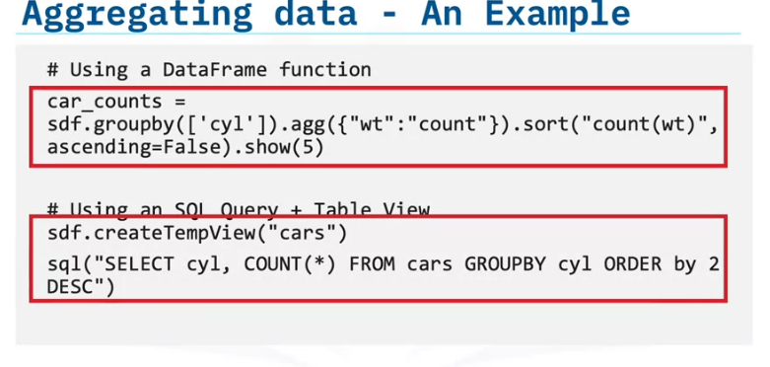
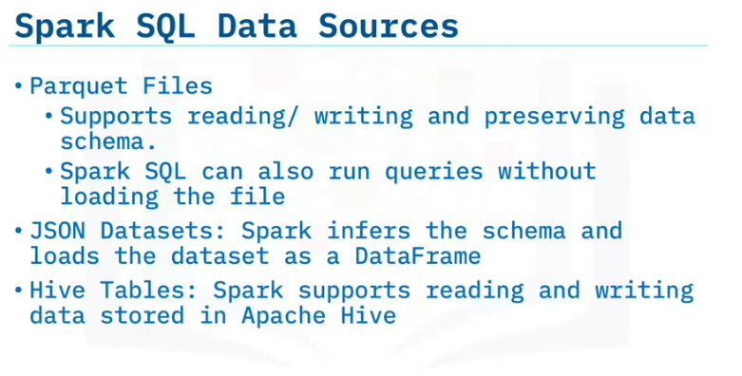
In this example, you aggregate and group cars by the number of cylinders they have.
You can perform this action using two methods: The first method is to use the inbuilt functions of the DataFrame. You have already covered this operation in another lesson.
The second method is to create a temp view for the DataFrame. In this example, you name the temp view "cars."
Then, you run a SQL query to group by cylinders and view the data in descending order.
Although you use different tools and functions, both approaches produce the same results.
Next, let's look at some of the data sources that Spark SQL supports.
Parquet is a columnar format supported by many data processing systems.
Spark SQL supports reading and writing data from Parquet files, and Spark SQL preserves the data schema.
Similarly, Spark SQL can load and write to JSON datasets by inferring the schema.
Spark SQL also supports reading and writing data stored in Hive.

Slide 27
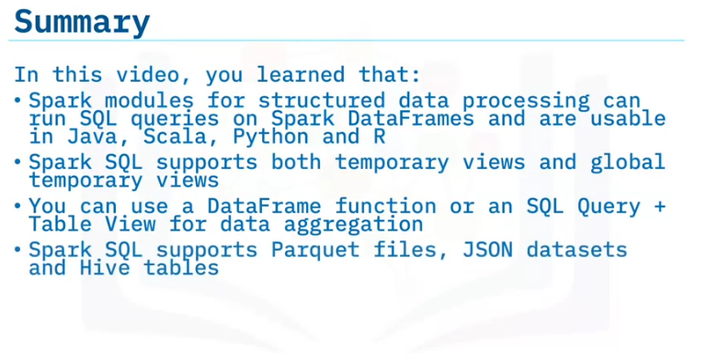

Slide 28
Summary & Highlights
In this module, you learned that:
RDDs are Spark's primary data abstraction partitioned across the nodes of the cluster. Transformations leave existing RDDs intact and create new RDDs based on the transformation function. With a variety of available options, apply functions to transformations perform operations. Next, actions return computed values to the driver program. Transformations undergo lazy evaluation, meaning they are only evaluated when the driver function calls an action.
A dataset is a distributed collection of data that provides the combined benefits of both RDDs and SparkSQL. Consisting of strongly typed JVM objects, datasets make use of DataFrame typesafe capabilities and extend object-oriented API capabilities. Datasets work with both Scala and Java APIs. DataFrames are not typesafe. You can use APIs in Java, Scala, Python. Datasets are Spark's latest data abstraction.
The primary goal of Spark SQL Optimization is to improve the run-time performance of a SQL query, by reducing the query’s time and memory consumption, saving organizations time and money. Catalyst is the Spark SQL built-in rule-based query optimizer. Catalyst performs analysis, logical optimization, physical planning, and code generation. Tungsten is the Spark built-in cost-based optimizer for CPU and memory usage that enables cache-friendly computation of algorithms and data structures.
Basic DataFrame operations are reading, analysis, transformation, loading, and writing. You can use a Pandas DataFrame in Python to load a dataset and apply the print schema, select function, or show function for data analysis. For transform tasks, keep only relevant data and apply functions such as filters, joins, column operations, grouping and aggregations, and other functions.
Spark SQL consists of Spark modules for structured data processing that can run SQL queries on Spark DataFrames and are usable in Java, Scala, Python and R. Spark SQL supports both temporary views and global temporary views. Use a DataFrame function or an SQL Query + Table View for data aggregation. Spark SQL supports Parquet files, JSON datasets and Hive tables.

